Slide 1
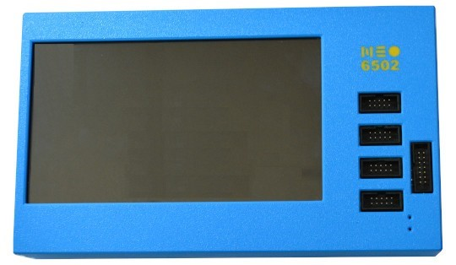
Built-in LCD
Display
4x UEXT
Connectors
14-pin external
12 GPIO connector
Built-in Battery status LED
External Power LED

Slide 2
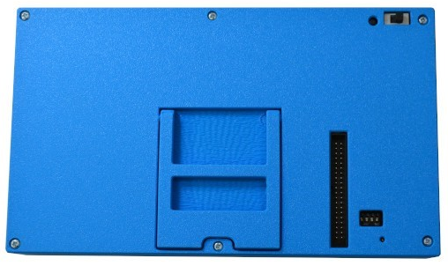
Foldable stand for case
W6502 External Bus
Boot/Flash
Button
Programming
Switch
Configuration
Switches
Piezoelectric Buzzer Speaker

Slide 3
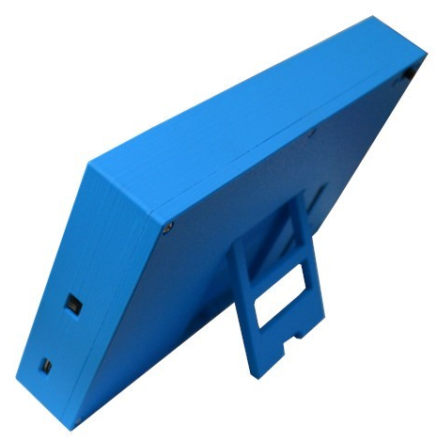
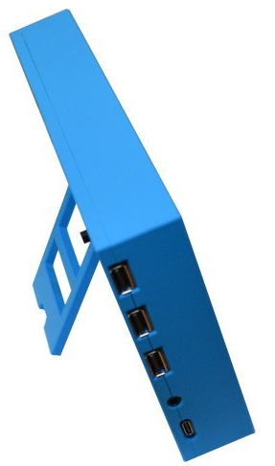
Foldable stand for case
3x USB-A ports
3.5mm Audio Port
Power On/Off Switch
USB-C Programming Port
USB-C Power Port

Slide 4
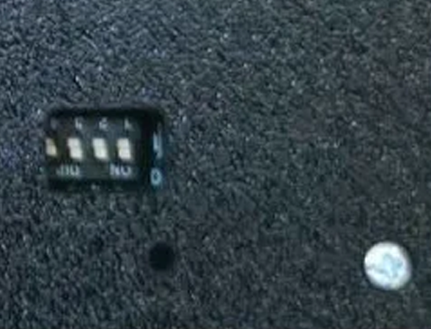
4 3 2 1
OFF (open)
ON (closed)

Slide 5
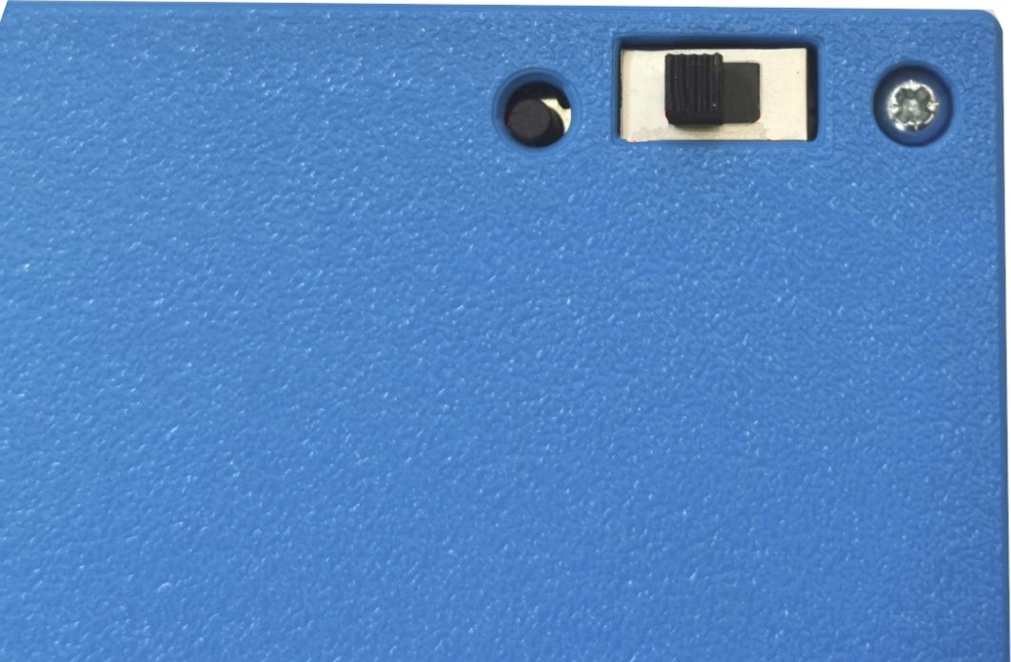
Programming Switch
Run
Position
Program
Position
Boot
Switch

Slide 6
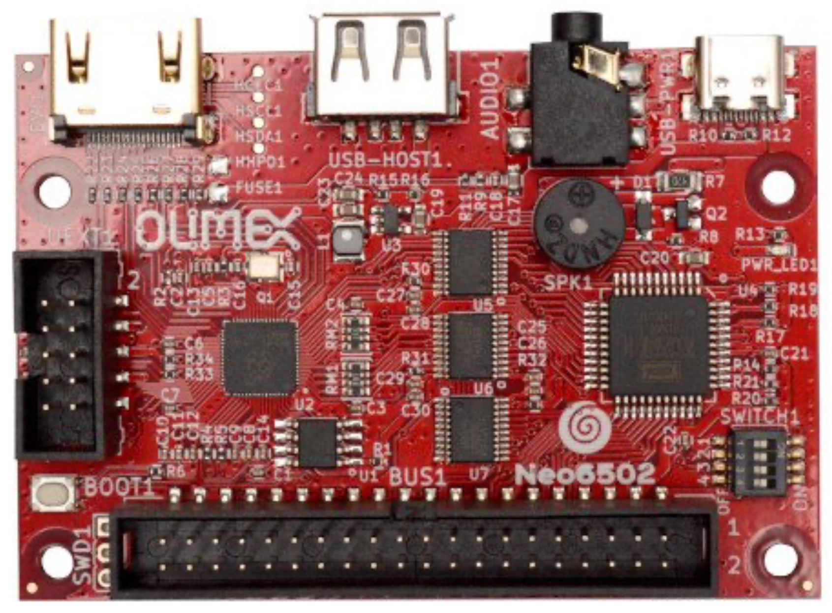
3.5mm Audio Port
USB-C Power Port
HDMI Connector
USB-A Port
RP2040
Piezoelectric Buzzer Speaker
UEXT Connector
W6502
Boot button
For programming
Configuration Switch Block
2MB of Flash Memory
W6502 Bus

Slide 7
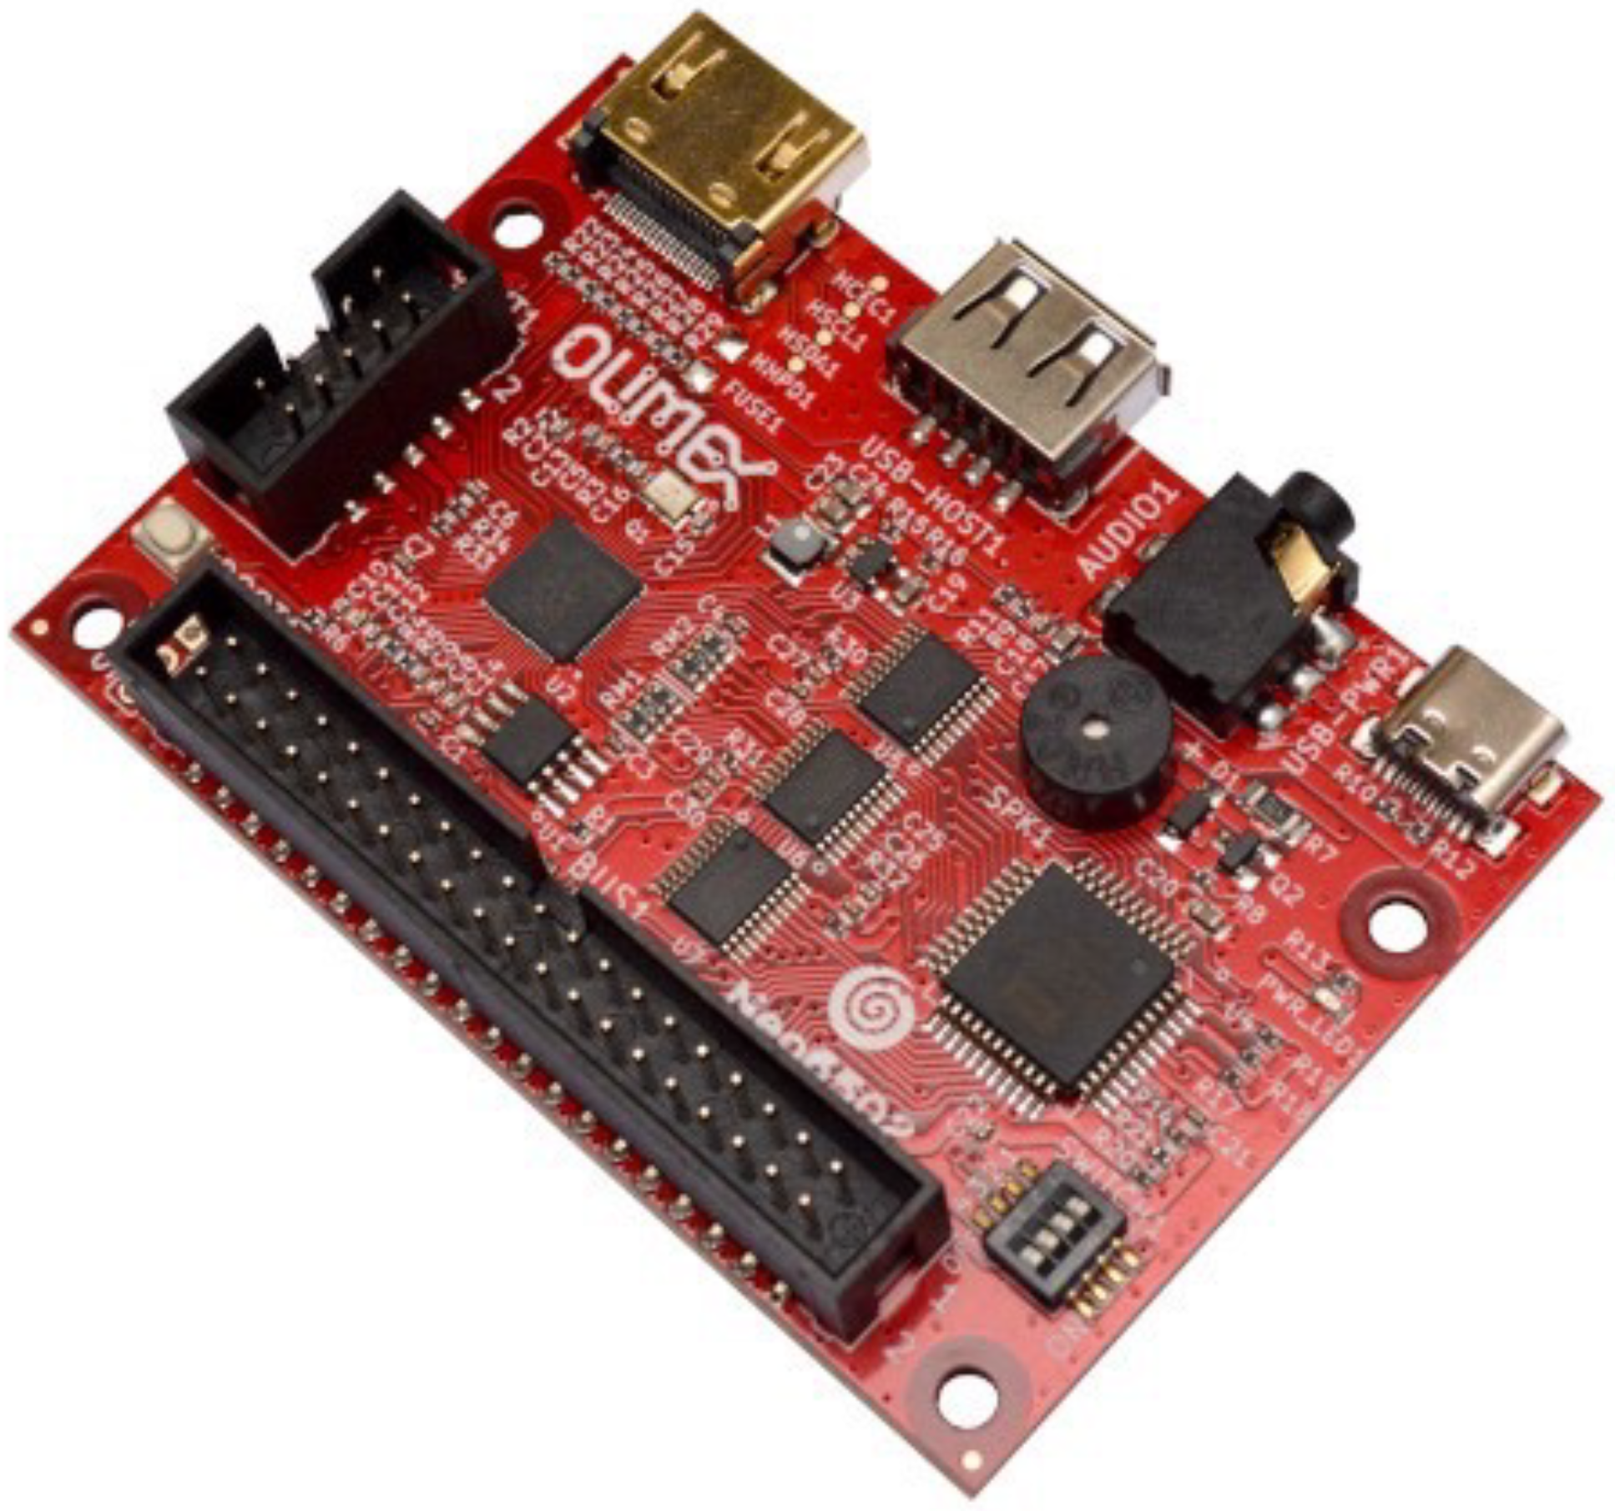

Slide 8
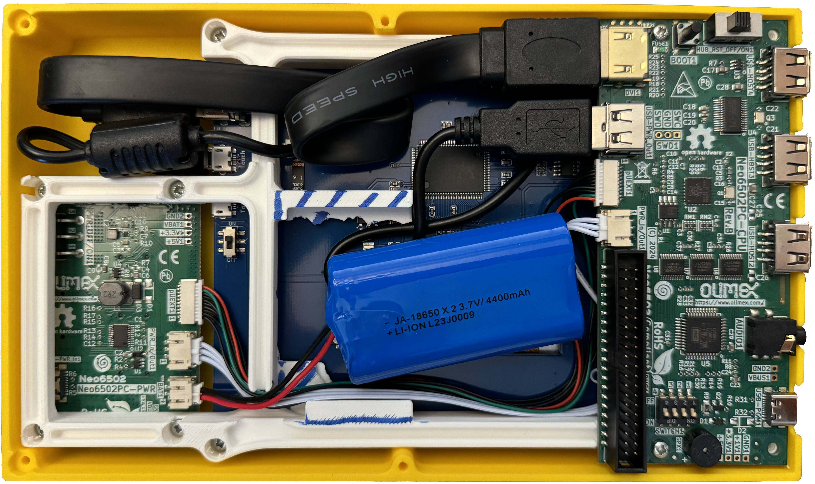
LCD Display USB Power
HDMI Cable Connecting Neo6502 to LCD Display
Boot button
For programming
Programming
Switch
USB-A Ports
RP2040
2MB of Flash Memory
Power On/Off Switch
Neo6502 Power and Charging Circuit
W6502
USB-C Power Port
3.5mm
Audio Jack
Piezoelectric Buzzer Speaker
Lithiumpolymer (Lipo) Battery
Configuration Switch Block

